Slide 1
Transmission Overhead Line Works
Safety Briefing Update
16th Feb 2016
Notes:
This safety briefing is a joint venture, an agreement between all parties to address some high level, serious incidents / accidents and provides and update on
Key initiatives and improvements seen through 2015.
This briefing and principles should be delivered and apply to all staff and contractors working on SSE / SPEN steel towers / transmission overhead line works.
Briefing should take place ideally in groups of maximum size of 20 will all staff to be briefed on return to work / major project re-commencements on SSE / SPEN projects in 2015.
Chargehands / Foremen and Engineers should ideally be briefed separately.
All project staff should be briefed and aware of principles including foundation and access works staff.

Slide 2
Notes:
Proposal is for forum to meet quarterly to continue to identify initiatives and areas for improvement in OHL safety performance.
This joint initiative has shown significant improvements in safety performance with participating companies a number of new companies have requested or
Been invited to participate to ensure all key contractors undertaking transmission OHL works for SSE and SPEN are represented.

Slide 3
Transmission OHL W@H Safety Forum
Forum established 2014 with main transmission line contractors, agreed that falling objects posed the most significant danger to staff and site operatives.
Initiatives implemented including danger zone control / tool tethering and rolled out during briefing of safety critical rules in Jan 2015.
Consistent approach introduced across all transmission overhead line contractors working for SPEN / SSE.
Anonymous survey of UK transmission OHL line teams undertaken to obtain data in 2014 and post introduction of initiatives 2015.
Exceptions to key safety critical rules refreshed by forum in 2015.
Results
Significant reduction in objects dropped over previous year survey.
70% reduction in high impact objects dropped over previous survey.
Notes:
The intial main focus of the group was been to look at objects falling from height as this was agreed as a key area of concern following a number of high potential falling object incidents i.e. presshead die / spacer damper / running block / hand tools. Significant high potential incidents in 2014, initiatives introduced in 2015.
A number of instances where significant objects struck individuals on the head.
It was estimated that the vast majority of falling objects were unreported and no true data was available on the scale of the issue.
Initiative implemented via anonymous survey in 2014 and follow up survey in 2015 to assess improvments.
Follow up meeting following introduction to agree exceptions to declared safety critical rules.

Slide 4
Summary of Objects Dropped | 2014 | 2015
Washers / Split Pins/ Lashings / Pens Scotch Tape and Nuts | 126 | 62
Bolts / Dowel Pins / Earth Braids | 60 | 16
Conductor Shoes / Vibration Dampers / Spacer Dampers / Bonding Spacers / Lugs | 26 | 4
Socket / Adjustable Spanner / Podger | 42 | 8
Arcing horn / Platform / Running Block | 3 | 0
Total Items Dropped | 277 | 90
Survey Sheets Returned | 128 | 80
Notes:
Use this slide to highlight the survey report and the findings.
Significant reduction in objects dropped following introduction of safety critical rules.
Surveys were anonymous and carried out over a 1 week period
128 surveys returned in 2014 / 80 in 2015 reduction due to reduction in OHL works being undertaken in survey period.
In 2014 survey almost 50% of the objects dropped could of resulted in a significant injury – or possibly a fatality.
In 2014 Average of 2 objects dropped per gang / week 1 minor / 1 major.
In 2015 survey reduction to 30% of the objects dropped could of resulted in a significant injury – or possibly a fatality.
In 2014 Average of 1 objects dropped per gang with majority being minor.
Proposal is to revisit survey again in 2016.
Key message to reinforce is the importance of reporting dropped objects, the true scale of dropped objects was not visible.
reporting of ALL falling objects. Number and type of objects dropped will vary based on works being undertaken.
A number of incorrectly completed sheets were excluded.
Ask staff to consider there own teams and discuss values obtained.
Consider correct storage of materials for works at height, majority of companies have made improvements to toolbags and tethers used through 2015

Slide 5
Notes:
Demarcation for hazard zone is installed 5m horizontal distance from point of works.
Over 99% of objects fell within exclusion zone.
95% in 2014 and 99% in 2015 of objects fall within tower or 5m of tower extents.
Majority of objects falling further than 5m from tower fell during platform works if 5m exclusion was in place from
extent of platform then object fell into exclusion zone.
Survey data validates that extents of exclusion zone normally implemented at 5m are correct.
Broad categories were used. 50% of handtools objects were either ratchets or sockets.
A number of object falling from ropes lashings during lifting operations consider are knots / lashings the
most appropriate method for objects?

Slide 6
Transmission Overhead Lines
Safety Critical Rules
Notes:
With involvement from all companies and with agreement from senior company management, we have developed and refreshed a set of clear rules that shall be applied
across SPEN and SSE Transmission Overhead Line sites.

Slide 7
Transmission OHL Safety Critical Rules
Permanent Attachment shall be applied when working at height
100% Compliance with Safety Rules / Safe System of Works / Emergency Procedures
Danger Zone shall be Physically Demarcated (minimum of continuous rope or chain) and access shall be controlled by a nominated person
No entry into a danger zone without permission and positive verbal confirmation from the nominated person that all works and movement above have stopped
Hand tools shall be tethered when in use or captive when not in use
All equipment and materials shall be secured, raised / lowered and used in a controlled manner.
Working above / below another activity which is in progress is prohibited unless unavoidable for specified OHL activities.
Supervisors shall be positioned to allow control and communication with all team members.
All Incidents / Near Misses / Hazards shall be reported as per client / employer requirements.
Notes:
Discuss each rule, highlight that they are not something nice to have, but are a mandatory requirement.
They shall be considered, used and applied at ALL times.
Permanent attachment at all times when working at height.
Demarcation: clarification for majority of construction type works it is anticipated that persons controlling access / egress to
Danger zone will be ground based. In the case of minor works i.e. works on a tower requiring maximum 2 man gang then
alternative safe method of control may be proposed i.e. if normal access point is closed / signage posted and 1 x persons on
tower designated responsible for monitoring and controlling danger zone, in the event of approach by any persons to danger zone
works above should be suspended and staff descend tower to intervene.
100% compliance with Safety Rules (i.e. Client Electrical and Mechanical Safety rules (Safety from the system)
and Safe Systems of Work (i.e. compliance with RAMS)
Access shall be controlled by a Nominated Person (nominated Person shall be recorded on the Site Specific Risk Assessment) this person will request works to stop, confirm it is safe to enter danger area and confirm when areas below are clear and works above may re-start.
All equipment and materials shall be secured, raised / lowered and used in a controlled manner. (This rule has been put in place due to the number of incidents relating to falling objects when not secured/lashed adequately and evidence of “Bombing” items).
Supervisors shall be positioned to allow control and communication with all team members. (Supervisor in this case is the Named Supervisor that has briefed and signed onto the Site Specific Risk Assessment – Setting to Work Brief. To alleviate any fears of non compliance only 5% of all 2014 SPEN incidents were found to have been caused by a wilful breach following investigation)
All Incidents / Near Misses / Hazards shall be reported as per client / employer requirements. (This has been made a safety critical rule due to the clear lack of reporting “Falling Objects” specifically as detailed in the previous slides)
Working above / below another activity which is in progress is prohibited for the majority of OHL activities and is only acceptable where appropriate control measures / methods have been approved by the Contractors Site Engineer and notified to the clients representative and only where this is part of the same work activity. All works MUST stop above (i.e. no movement) when any persons require to enter the exclusion zone or below works.
6 x activities have been identified where compliance cannot be achieved and are considered agreed exceptions.
Printed / Laminated copy of safety critical rules are to be reissued in 2016 for each member in the audience to sign. It is essential that each operative has a clear view of these rules.

Slide 8
Transmission OHL Works Required Practice
Materials and equipment to be taken above ground level should be minimised.
Method Statements shall detail minimum resources required for works.
All changes to Method Statement / Works sequence shall be approved by the agreed management of change process and documentation updated prior to implementation at site.
All staff shall receive a daily setting to work briefing from their nominated supervisor.
Site Engineering staff should target a minimum 50% of time on site during work activities *
All works should be planned and detailed on look ahead programme and co-ordinated
A minimum distance of 3m must be maintained between climbers during access / egress of towers.
Notes:
A number of points are targeted at Supervisory levels / pre-planning.
Site engineering staff / nominated supervisor is not part of the working party but is part of the method statement development and approval / change process.

Slide 9
Agreed Exceptions to Rules
Instances where working above / below each other cannot be avoided are:
Erecting / dismantling tower / part towers if weight limitation / tower type does not allow assembly on ground.
During combined re-insulation and blocking on suspension towers.
Checking Jumpering Depths only applicable on wedge clamps / measuring device shall be tethered when in use.
Square Rigging / Endless Rope Installation and tensioning to prevent snagging / Dressing / controlling OPGW tail down tower.
Reposition of platform tirfor bond during installation and movement / removal on inside of angle towers.
Earthing of conductors any operatives below not earthing should be positioned at tower body.
Notes:
Instances where working above others which cannot be avoided are:
Erecting / dismantling tower / part towers if weight limitation / tower type does not allow assembly on ground where operatives
must be located on tower to complete connections.
During combined re-insulation and blocking on suspension towers operative on crossarm and conductor.
Checking Jumpering Depths only applicable on wedge clamps / measuring device shall be tethered when in use.
Square Rigging and Endless Rope Installation and tensioning to prevent snagging.
Reposition of platform tirfor bond during platform installation and movement / removal on inside of angle towers.
Earthing of conductors, operatives below not applying earth should be positioned at tower body.
Any new activities identified should be table at quarterly meeting for consideration prior to inclusion above on agree exception to rules.

Slide 10
IF IN ANY DOUBT.
Notes:
Staff should be clear that if there is any doubt regarding site works to refer to supervisor.
The supervisor may not always be correct e.g. incident in SPEN where whole team challenged proposed method but still
continued on instruction of supervisor who was eventually injured.
Stop and if not satisfied with immediate supervisor response ask for matter to be referred to next level Foreman / Engineer etc.
Do not start or continue works if you have any concerns.
Issues may need to go higher and possibly be documented prior to proceeding?

Slide 11
Consequences
Post Incident
Breach of any of the above safety critical rules will lead to immediate removal from site by your employer and where applicable client authorisations temporarily removed pending investigation.
Post Investigation
Any individuals found to have wilfully breached any of the safety critical rules shall have client authorisations where applicable removed for a minimum period of 3 months.
Any Supervisors found to have wilfully breached any of the safety critical rules shall have client Supervisor authorisations where applicable removed for an additional period of 12 months.
Evidence of retraining / coaching / competence and assessment shall be presented by the employer before re-authorisation will be considered.
Investigation lessons learned where relevant shall be shared between parties.
Notes:
Suspension post incident of individuals involved is required to prevent any repeat while investigation identifies issues.
Investigations need to be open and transparent.
In the majority of major incident investigations stats indicate 95% of failures are due to process / procedure / training.
only 5% are due to wilful actions.
Individuals must co-operate fully / key to this is early notification and preservation of incident site once made safe.
Individuals will have authorisations removed for wilful / knowing breach.
Minimum 3 months to restore basic authorisations. (WI 1/2 in case of SPEN)
Minimum further 12 months to restore supervisor authorisations (i.e. SR3/4 in case of SPEN) after reinstatement of basic authorisations.
Investigation recommendations and key lessons learned where relevant shall be shared between parties.
(names of individuals involved would be shared between involved contractor and client only)
Individuals will have authorisations removed for wilful / knowing breach.
(Note only 5% of all incidents are found to have been caused by a wilful breach)

Slide 12
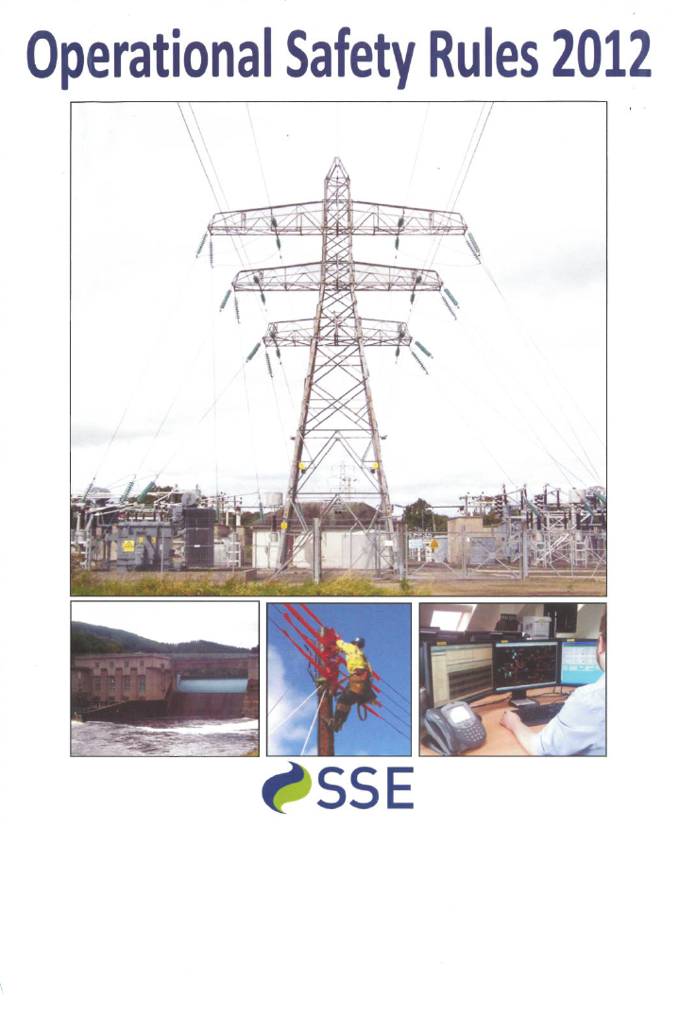
SSE
Safety Rules
Photo
Notes:
We have rules, procedures to ensure a safe system of work and to ensure compliance with legislation, guidance, best practice.
Rules and procedures have been developed over the years following previous incidents, other have learned the hard way
Ignoring procedures places individuals at greater danger of injury.
Use this slide to discuss the consequences of breaching a safety critical or required practice (the possibly consequences)
If individuals do not follow safe systems of works SPEN / SSE do not want these individuals working on their network.
Next key initiative will be in relation to SSE and SPEN Safety Rules.
SPEN have revised safety rule and PSSI’s backstop date for all staff to have been briefed / trained is 31st March 2016.
Hard copies of SPEN safety rules will no longer be issued to authorised staff, access to hard copies / electronic versions must be available to staff.

Slide 13
Remember:
Follow and stick to the rules.
Look after yourself and also your work colleagues.
Always challenge an unsafe act or practice.
“Don’t become
another statistic”
Notes:
Summary key is that we wish staff to return home from work in same condition they arrived at work.

