Slide 1
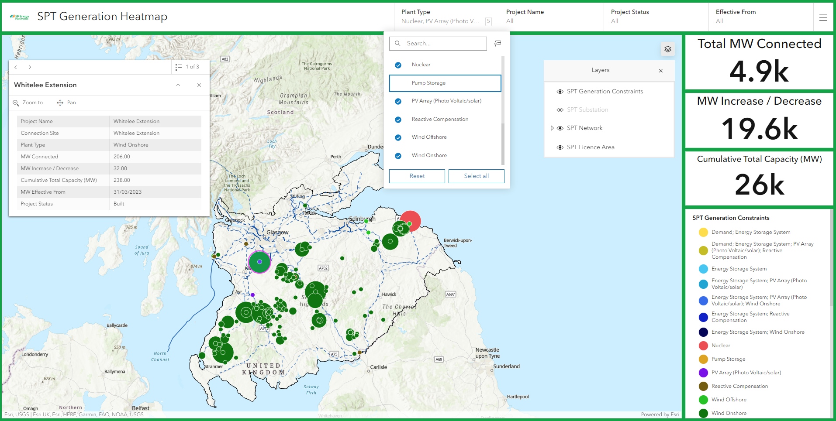
SP Transmission – Generation Heat Map – User Guide
The header of the pop-up indicates if information is available for more than one record at that location, and the arrows on the right of the header allow you to scroll through the information for each record
Filters – these filters allow you to select one or more values in each list, for example allowing you to filter on a specific set of Plant Types and Project Statuses. The map and the indicators update to reflect any filters applied.
Asset pop-ups – clicking on a record provides more information on that record
Layer Control – click here to open the Layer Control which allows you to switch layer visibility on and off
Indicator Panels – give a summarised view of the level of MW for three main indicators. These values will update to reflect any filters applied to the map
Legend – gives information on the symbols and layers which are currently visible

